Slide 1
THIRD WHEEL PARKING LOT
ALAMAG | MARCELLANA | MELAD | REYES | SUAREZ | TOLENTINO

Slide 2


Slide 3
TABLE OF CONTENTS
01
04
02
05
PROJECT DESCRIPTION
DELIVERABLES
PROJECT SCOPE
FLOWCHART
03
OBJECTIVES
06
CLIENT/USER REQUIREMENTS

Slide 4
TABLE OF CONTENTS
07
10
08
11
SUCCESS FACTORS
PROJECT SCHEDULES AND MILESTONES
REFERENCES
PROJECT TEAM ROLES AND RESPONSIBILITIES
09
IMPLEMENTATION
QUESTION AND ANSWER
12

Slide 5
PROJECT DESCRIPTION
01

Slide 6
PROJECT DESCRIPTION
Third Wheel Parking Lot is an application designed to serve its future clients and users to help them park easily having minimal contact. Its target clients are those who own parking lots like malls that are being rented by consumers. The transactions within the application will be recorded inside a log function where users can see the application’s documentation that is updated every time there is a change in the system.

Slide 7
02
PROJECT SCOPE

Slide 8
PROJECT SCOPE
Describe the work to be accomplished.
What is the purpose or business of this project?
Who are the stakeholders/users?
A technologic parking lot application that allows the user (i.e., parking teller) to pinpoint and assign parking space within the parking area. Moreover, the application has features such as user login and user logout. Furthermore, the capacity of choosing and removing desired parking space, all in which are recorded in the history log can be discovered through the app.
The purpose of this application is to render assistance for the parking tellers who facilitate renting processes in an easy and convenient way to manage their businesses virtually.
Any company establishment who owns a parking lot space who uses it for profit are the most favorable users of the application. The system would serve as a guideline application for every parking teller in every parking lot space.

Slide 9
03
OBJECTIVES

Slide 10
SCHEDULE OBJECTIVES
To be able to develop and implement a Parking Lot application with the use of Python within the given time period.

Slide 11
TECHNICAL OBJECTIVES
To authorize the park tellers on the smooth management of the parking lot status to prevent congestion and traffic in the parking lot spaces. Moreover, authorization of park tellers to view the logs; time stamp, park in and out, park counter, and daily count. As well as the conducive flow of traffic inside the parking space.

Slide 12
04
DELIVERABLES

Slide 13
INTERNAL DELIVERABLES
01
02
03
04
Initial System Code in Python Format
Testing and Debugging Results
Final System Code in Python Format
Flowchart
05
06
07
Executable File
Documentation
System Logo

Slide 14
EXTERNAL DELIVERABLES
1
2
Display Parking Lot and Status
Logging In
3
Do Transaction
Park
Unpark
4
View Logs
Table
Bar Graph
5
Logging Out

Slide 15
05
FLOWCHART

Slide 16
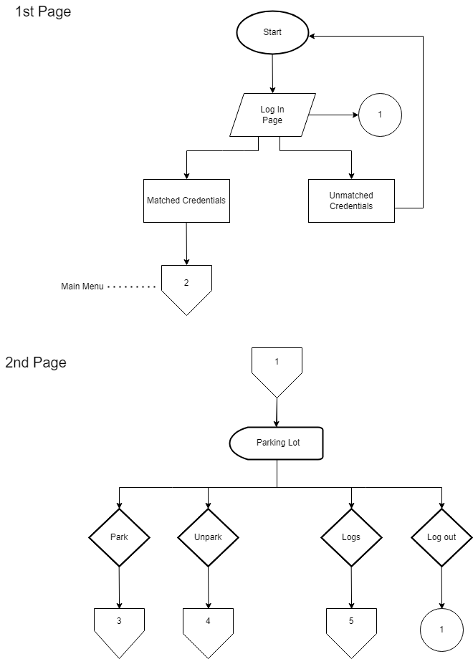

Slide 18
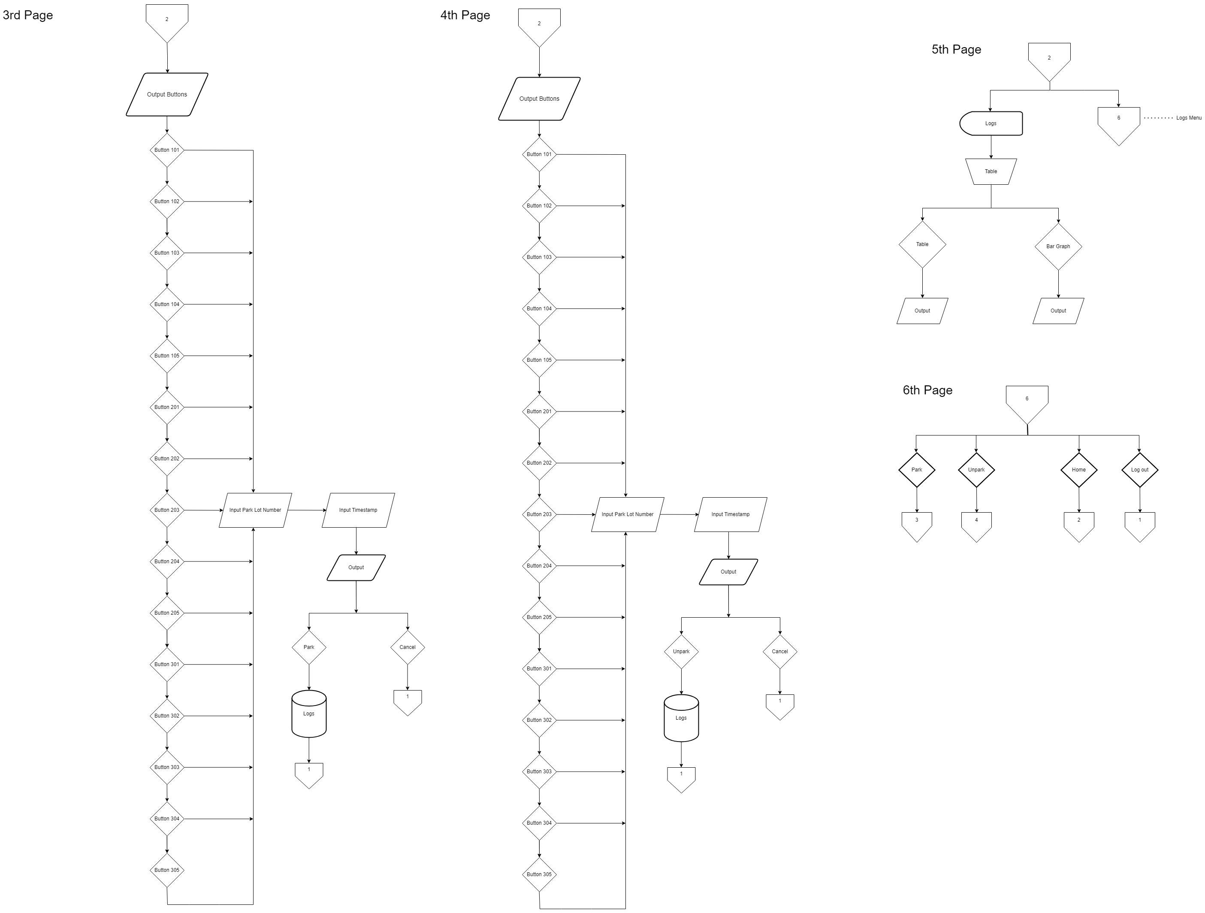
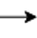
a
b
a
b

Slide 19
c
d
c
d

Slide 20
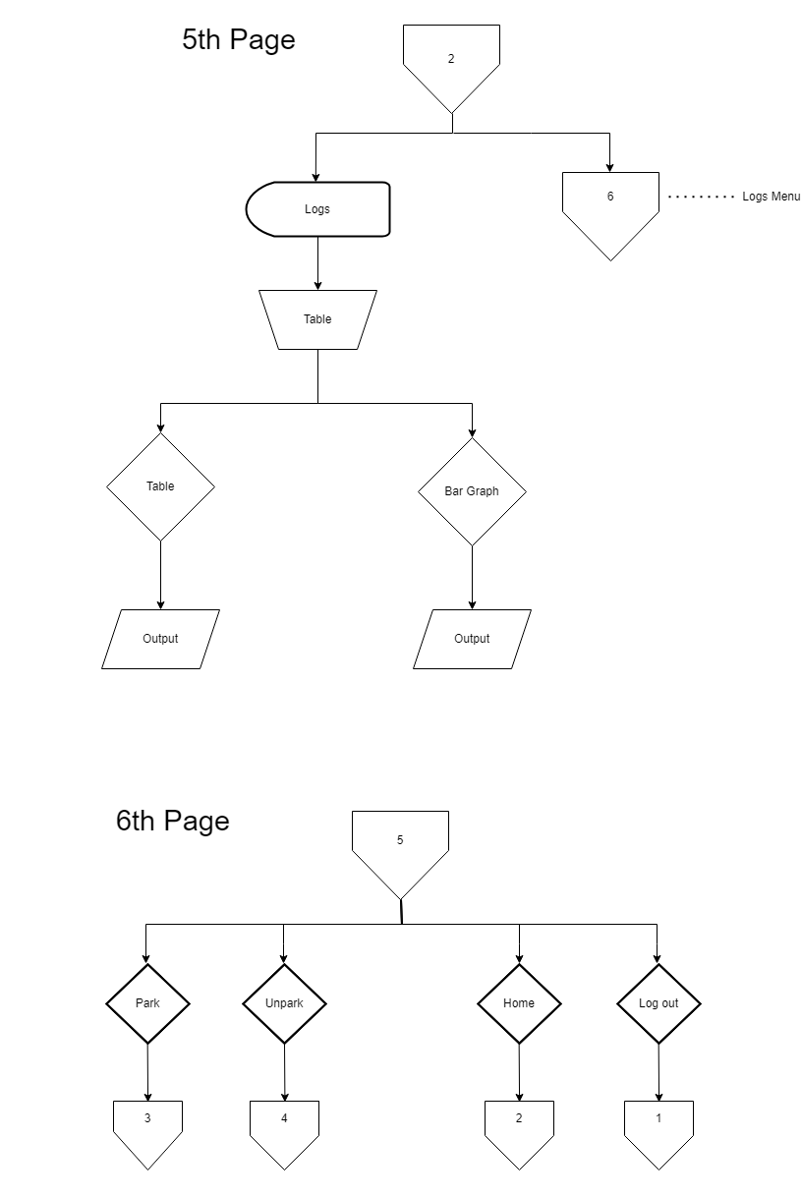

Slide 22
CLIENT/USER REQUIREMENT
06

Slide 23
CLIENT/USER REQUIREMENT
A database administrator and a parking teller that will monitor the Third Wheel Parking Lot can access all the features of the system.
The system allows the user to monitor the Third Wheel Parking Lot with the functions of park– which will be used once a client parks, unpark– when the client unparks, and logs– which allows the user to see the data of the parking lot, such as the timestamp, the parking lot number where client parks or unparks, and a daily count.

Slide 24
SUCCESS FACTORS
07

Slide 25
SUCCESS FACTORS
The Users and Clients of the Third Wheel Parking Lot are satisfied.
All the Objectives of the project are achieved.

Slide 26
PROJECT TEAM ROLES AND RESPONSIBILITES
08

Slide 27


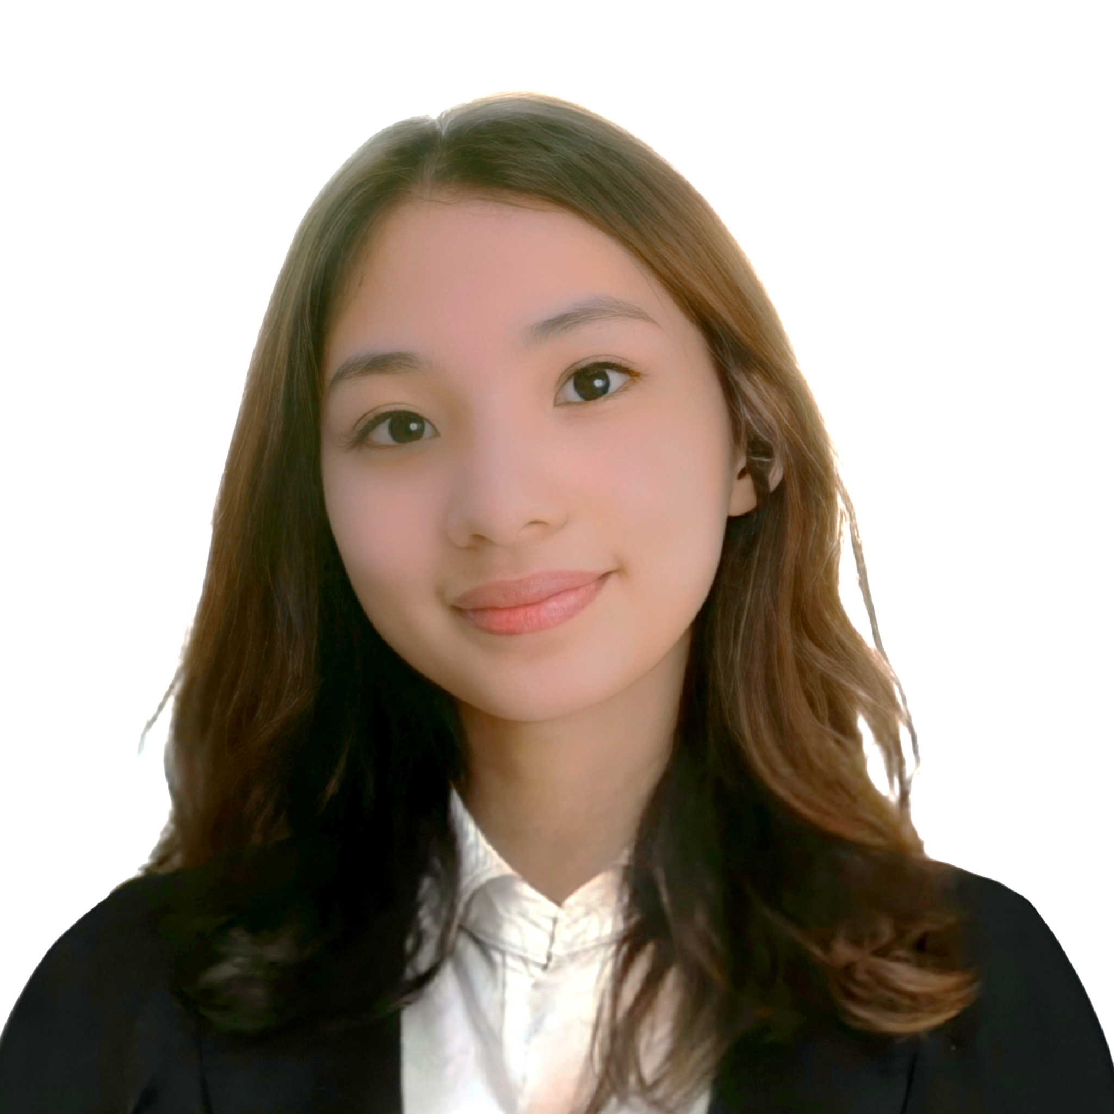


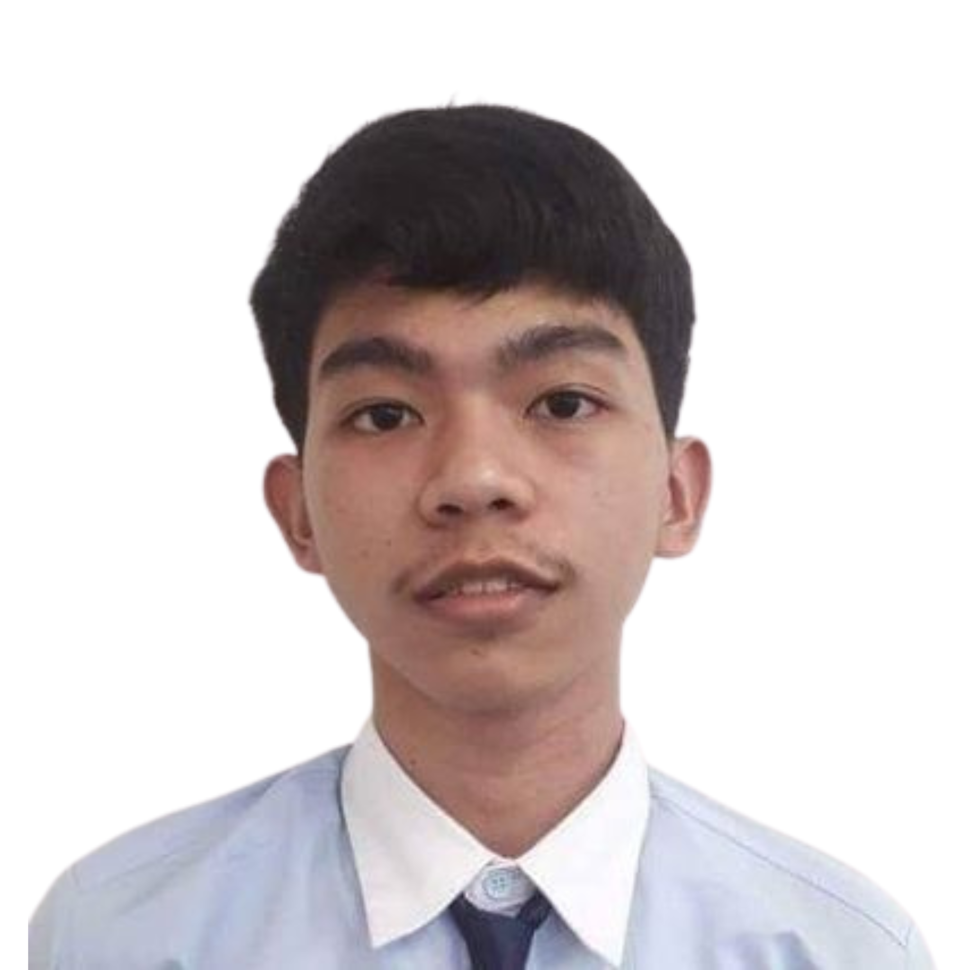
Winzelle Anne Tolentino
Jose Luis Alamag
Nicole Marcellana
System Designer
Project Manager
Technical Writer
Mark Angelo Reyes III
Nicole Jewel Melad
Edrin Ivan Suarez
System Developer
Business Analyst
System Analyst

Slide 28
09
IMPLEMENTATION

Slide 29
IMPLEMENTATION
TASKS/ACTIVITIES
PROCEDURES
TOOLS/TECHNOLOGY
PROJECT CHANGE CONTROL PROCESS
Produce, Design, Develop, and Present a System.
Agile Methodology: SCRUM
Python, Figma, and Tkinter Designer
SCRUM using iteration process

Slide 30
PROJECT SCHEDULE AND MILESTONES
10

Slide 31




PROJECT SCHEDULE AND MILESTONES
PHASE 1
PHASE 2
PHASE 3
PHASE 4
PROJECT
IDENTIFICATION
PROJECT DESIGN PROTOTYPE
PROJECT PROTOTYPE
DEVELOPMENT
PROJECT PROTOTYPE
PRESENTATION
December 04, 2022
December 10, 2022
December 14, 2022
December 16, 2022

Slide 32
PROJECT SCHEDULE AND MILESTONES
PHASE 5
PHASE 6
PHASE 7
PHASE 8
GATHERING
DATA SUPPLY
FINAL PROJECT DESIGN
FINAL PROJECT
DEVELOPMENT
FINAL PROJECT
PRESENTATION
February 14, 2023
February 16, 2023
February 19, 2023
February 21, 2023

Slide 33

PROJECT PRESENTATION

Slide 34
11
REFERENCES

Slide 35
REFERENCES
https://github.com/ParthJadhav/Tkinter-Designer https://www.youtube.com/watch?v=7A9j8kxvI98&t=62s https://www.youtube.com/watch?v=m061SFifdi8
https://www.tutorialspoint.com/python/python_gui_programming.htm

Slide 36
QUESTION AND ANSWER
12

Slide 38
THANK YOU!
ALAMAG | MARCELLANA | MELAD | REYES | SUAREZ | TOLENTINO

